Slide 1
Education Cluster
Carroll 2030 Task Force
April 19, 2013

Slide 2
Cluster Representatives
Carroll County Public Schools – Stephen Guthrie
Carroll Community College – Karen Merkle
Carroll County Public Library – Lynn Wheeler

Slide 3
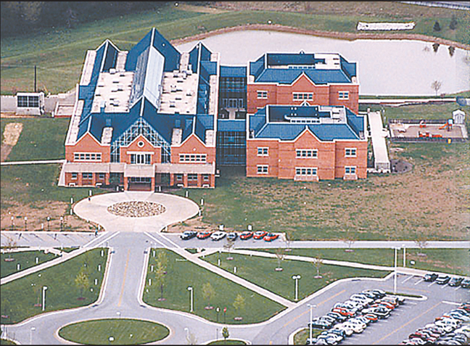
How much change can we expect in 20 years?

Slide 4
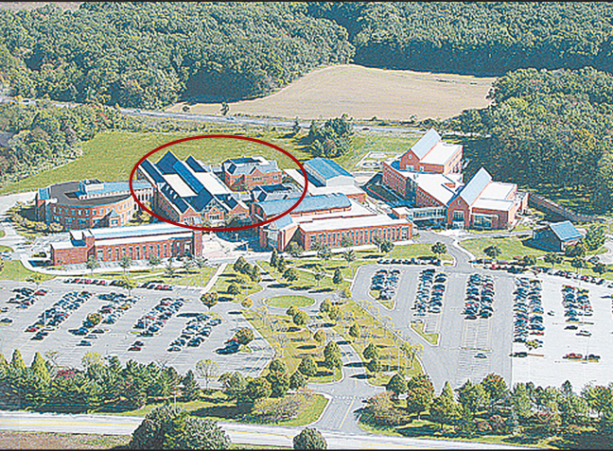
We can never predict

Slide 5
Limitations of 17-year planning
Technology in 2030 is difficult to predict
Requirement to adhere to increasing federal and state mandates on local education agencies
Shifting financial priorities of federal, state and local government agencies

Slide 6
Assumptions
The role of education will continue to increase due to rapidly changing workplace demands that require constant lifelong learning
Carroll County will continue to grow and our community demographics will shift as we become a more diverse community
Access to and management of technology and data will be critical to avoid a have/have-not community
Community will increasingly look to the education sector to validate external online training, credentialing and proficiency
Community expects up-to-date and modern facilities
Access to technology, data, power and services during emergencies will be critical
Technology needs to be inter-operational among educational institutions
We must embrace a culture of strategic innovation and collaboration

Slide 7
Top Priorities to Meet Future Demands
Expand broadband and wireless infrastructure
Re-commit to including Infrastructure technology funds in the CIP
Invest in modernization and repurposing of existing space in public educational facilities to meet shifting needs of the community and to prepare the workforce to compete in a global marketplace
  Create technology-loaded collaborative workspaces to prepare students and community for new technologies in the workplace
Build a K-12/CCC joint career technology center
Continue to support economic and business development
Continue to pursue strong partnerships to meet continuing educational needs

